Slide 1


Proposal to build Enclosures App for Altech.
By Elmehdi AitBrahim October 2016

Slide 2

BACKGROUND
Taskmaster 2020 is an upgrade of Taskmaster 2000 with new features and ease of use.
Taskmaster 2020 is an application that manages MODAPTS studies and delivers world class reports.
MODAPTS: MODular Arrangement of Predetermined Times Standards.
MODAPTS system applies a modular concept, which relates time values to movements of a worker’s body.
Primary features of Taskmaster 2020:
UI enhancements for MODAPTS studies and reports.
Recurring subscription billing payments.
Target mobile devices such as smartphones and tablets.
Multi-tenant data architecture.

Slide 3

Solution and Engagement Approach

Slide 4
OUR APPROACH
Code Gate has derived Taskmaster 2020 feature list based upon Taskmaster 2000 and MODAPTS Practitioner Course and categorized the features based upon priority and dependency into 3 packages.
Inline with Eisbrenner objectives, the 3 packages address the following requirements of Taskmaster 2020 and its details are listed in subsequent slides:
Package 1: Core application with new MODAPTS studies and reports management
Package 2: Recurring subscription billing payments
Package 3: Taskmaster web site
Most of the Taskmaster 2020 features are new or fixe features from Taskmaster 2000.
Taskmaster 2020 will be built from scratch to assure the objectives listed above.
Code Gate also provides a timeline and a budgetary estimate for implementing the 3 packages as a solution to Taskmaster 2020.

Slide 5
Why rebuild Taskmaster?
Organize studies in structured way.
Display study detail in read mode.
Implement edit and copy actions for each study.
Implement selectable MODAPS code in pairing mode to build MODAPTS string instead of typing it out manually.
Display detail for each MODAPTS code while selecting it such as:
Element class: Movement, Terminal, and Auxiliary.
Movement class such as finger, hand, arm, shoulder, trunk with it usual distance.
The following slide shows the summary of new MODAPTS string builder:

Slide 6
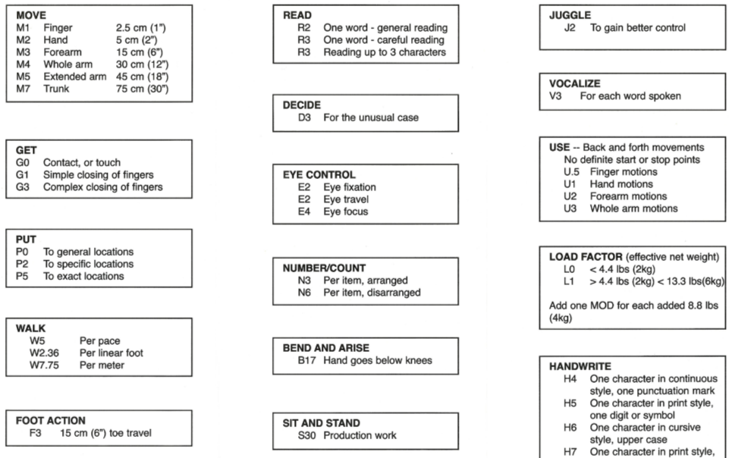

Slide 7
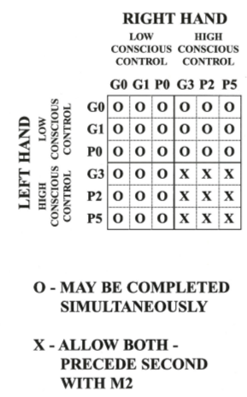
Why rebuild Taskmaster?
Implement MODAPTS code for right and left hands.
Implement rules for low vs. high conscious control.
Implement MODAPTS simultaneous rules.
Build a multi-client supported API (Application Programming Interface).
Use Taskmaster from a mobile oriented website and a desktop application.
Implement recurring subscription billing payments:
Plans management, Collect billing information.
Create subscription and handling its events: subscription trial will end, Invoice payment succeeded or failed.
Change plan, cancel subscription.

Slide 8
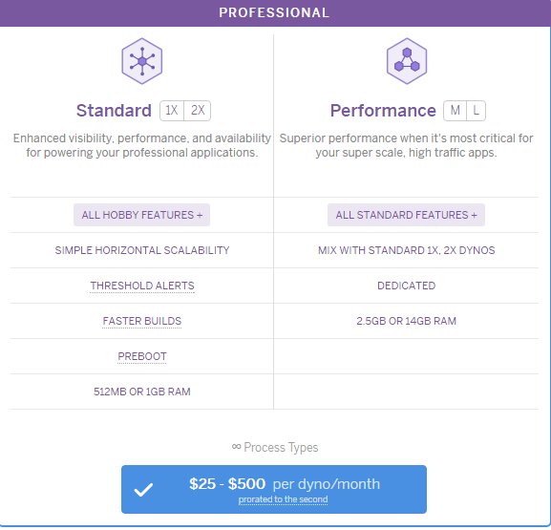
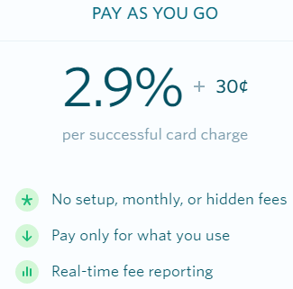
Why rebuild Taskmaster?
Minimize the operation costs by using open source technology stack, feature-packed payments, and cloud platform with integrated data services and a powerful ecosystem for deploying and running modern app.

Slide 9
PACKAGES
Taskmaster 2020 tool features and functionality is divided into the following packages
Core app
Study management
Productivity reports
Web site
Taskmaster description
Studies organization
Payments
Subscription billing
Process payments
Subscription events
Taskmaster features

Slide 10
FEATURE LIST – Core app
Study Management
R1 | Create and edit MODAPTS study | Create and edit study from any device. Save completed or in process studies. Copy a study.
R2 | MODAPTS Help guide | Written description with rules and recommendations. Very short video for each MODAPTS code.
R3 | MODAPTS string input | User selects MODAPTS code in pairing mode to build MODAPTS string. Rules for low/high conscience and simultaneous motions will be enforced upon each selection. Translating MODAPTS string to modules and time.

Slide 11
FEATURE LIST – Core app
Studies Organization
R4 | Work elements & steps | Order work elements and work steps by drag and drop operations.
R5 | MODAPTS Study storage | Store MODAPTS studies by plant, department/area, team/zone, station/operation.

Slide 12
FEATURE LIST – Core app
Productivity reports
R6 | OIS report | Operator Instruction Sheet generated from the element description fields.
R7 | Operator Utilization % | Unit Cycle Time, Cost Per Piece.
R8 | Work Balance Board | Bar chart for each station showing VA, NVA, NVABN. Bar chart with the element description and time.

Slide 13
FEATURE LIST – Payments
Subscription Billing
R9 | Subscription billing | Plans management. Collect billing information.
R10 | Process payment | Invoice payment succeeded or failed.
R11 | Subscription events | Subscription trial. Change plan. Cancel plan.

Slide 14
FEATURE LIST – Payments
Web site
R12 | Taskmaster description | Description content with images.
R13 | Taskmaster features | Feature list.

Slide 15
PROPOSED TECHNOLOGY STACK
Programming Language | JavaScript
Stuck Technology | MEAN
Payment online | Stripe
Charting library | D3
Supported OS | Windows / Linux
15

Slide 16

Time and Budgetary Estimate

Slide 17
TIME EFFORT ESTIMATES
Project Activities | Efforts in Person Hours
Learning MODAPTS / Analyzing code & requirements | 80.00
Core App development | 200.00
Payments development | 160.00
Web site development | 40.00
Testing and Validation | 120.00
Project Management / Meetings | 60.00
Total Efforts ( Person Hours ) | 660.00

Slide 18
BUDGETARY ESTIMATES
Project Activities | Total Time | Cost per H | Total Cost
Taskmaster 2020 project | 660.00 H | $70.00 / H | $46,200.00
Maintenance support | 1 Year | $0.00 / H | $ 0.00
Total Cost |  |  | $46,200.00

Slide 19
THANK YOU
Code Gate | 2016

